Slide 1
Launch of new iECHO platform for ECHO PANO May 14, 2024
iECHO aims to enable the exchange of knowledge globally and create a larger and more accessible learning community.
This new platform adds speed and sustainability to the ECHO platform and helps overcome the limitations of manual processing.
iECHO offers users a digital means to exchange knowledge and data needed to improve the quality and accuracy of complex problem solving.

Slide 2
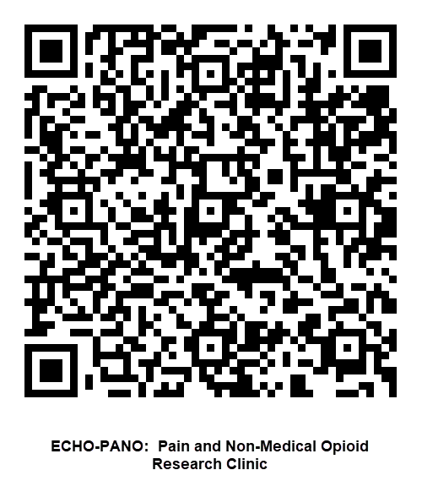
Please scan the QR code to register and join ECHO PANO in the new iECHO Platform
https://iecho.org/public/program/PRGM169755745874503R9P34AHF
We will send more details via email, please reach out to echo-pano@mdanderson.org with any questions.

Slide 3
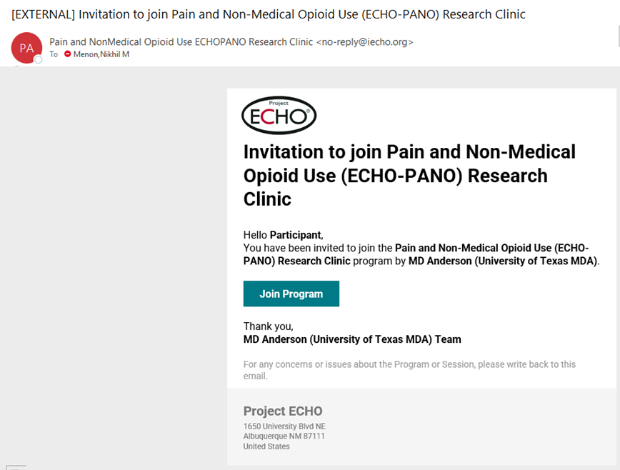
Example of email invitation

Slide 4


CCTS and MD Anderson ECHO Pain and Non-Medical Opioid Use Research Clinic
iECHO Instructions for Email Based Registration
The following slides contain the instructions for creating an iECHO account. You will be able to do the following once your account is set up.
Access all ECHO Projects that you have registered for
Access to all the content for specific ECHO Projects
  Didactics
  Recordings
  Supplemental Materials
iECHO will provide an automated email reminder 30 minutes prior to the session starting
  The email will include a link to sign in to your iECHO account or a direct Zoom link for the session
***Please note that the recommended way for setting up an account is via email and the phone number method is not available in the United States.***
Notes:
Presenter: Jay

Slide 5
CCTS and MD Anderson ECHO Pain and Non-Medical Opioid Use Research Clinic
iECHO Instructions for
Email Based Registration
Check your email for an invitation email from "ECHO Institute no-reply@iecho.org" and click on the button Register for program
    If you didn't receive the e-mail invite, try checking your spam folder
    ***If you still do not receive the invite or can’t access the iECHO website, then it is being blocked by your organization’s network firewall security
    We will work with your IT department to get it added to the allowable senders and website list
    Please contact us if this is the issue
Notes:
Presenter: Jay

Slide 6
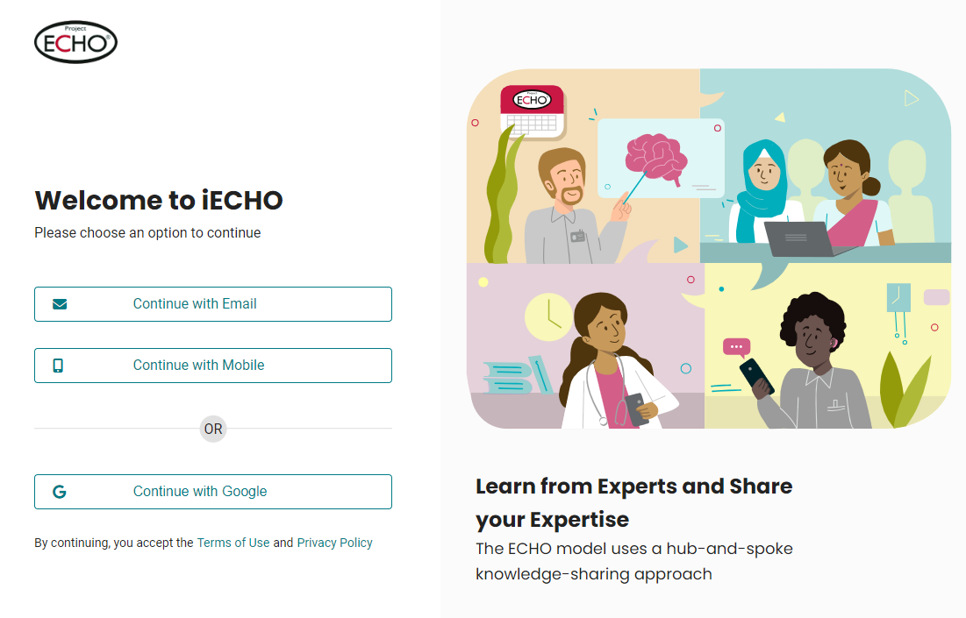

CCTS and MD Anderson ECHO Pain and Non-Medical Opioid Use Research Clinic
iECHO Instructions for Email Based Registration
You will be taken to iECHO. Follow the registration for email
Please use the email address you are most likely to use when signing into the account
  It can be a work or personal email address
Notes:
Presenter: Jay

Slide 7
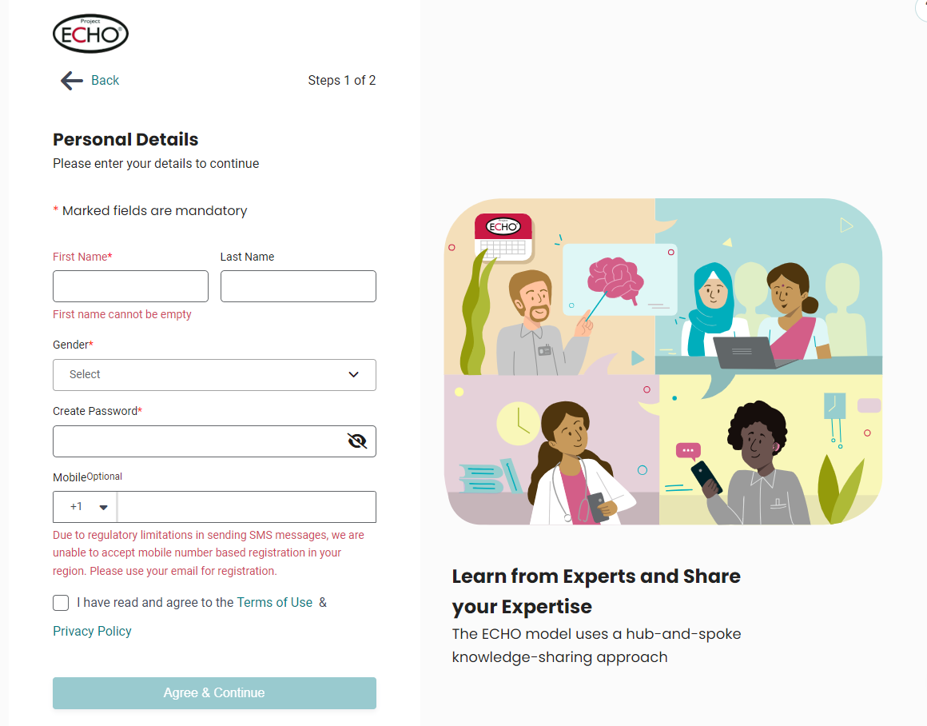
CCTS and MD Anderson ECHO Pain and Non-Medical Opioid Use Research Clinic
iECHO Instructions for Email Based Registration
Please fill out the personal details such as name and gender.
Create a secure password that will be easy for you to remember, but hard for an attacker to guess
    Your password must meet the following criteria.
        At least 10 characters
        At least one upper-case character (Capital letter e.g. A, B, C, --, Z)
        At least one numeric character (Numbers e.g., 1,2,3,4, --, 0)
Notes:
Presenter: Jay

Slide 8

CCTS and MD Anderson ECHO Pain and Non-Medical Opioid Use Research Clinic
iECHO Instructions for Email Based Registration
Select the checkbox next to the Terms of Use and Privacy Policy, and click on Agree & Continue
    By completing the registration, you provide your acceptance of iECHO's legal terms. We take data protection and data privacy very seriously at ECHO. If you have any queries or concerns around legal or data privacy matters, write to us at privacy@iecho.org
Notes:
Presenter: Jay

Slide 9
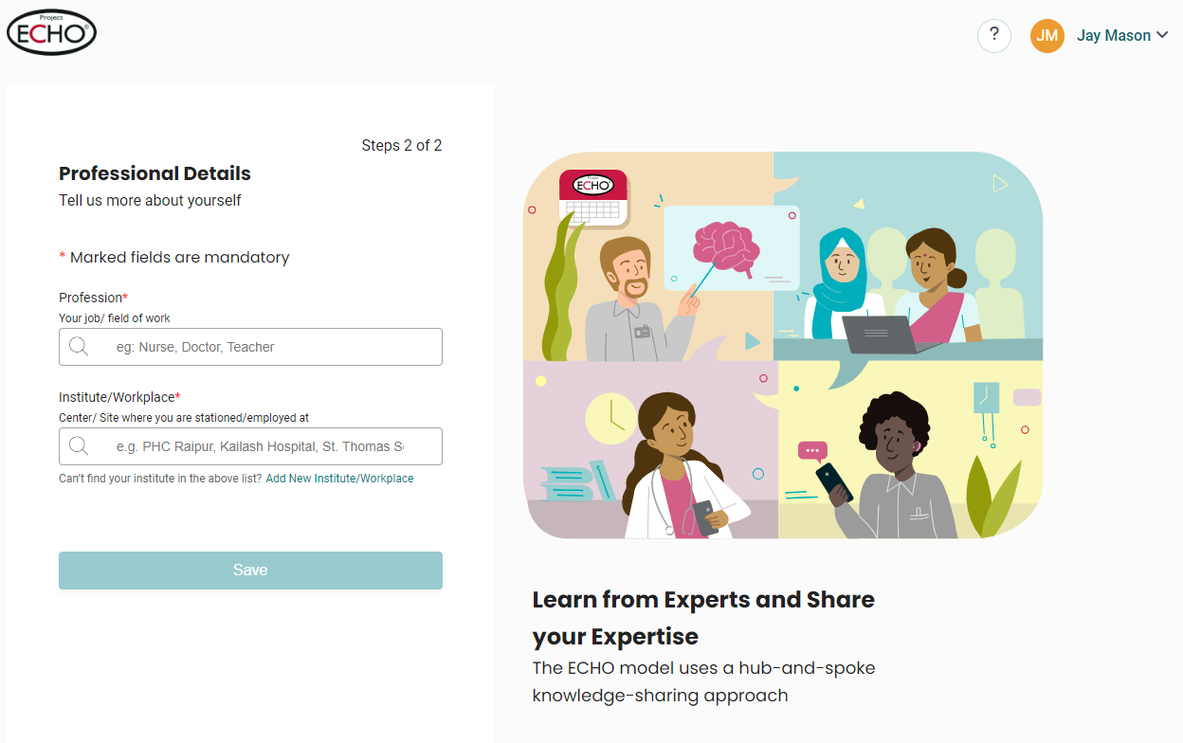
CCTS and MD Anderson ECHO Pain and Non-Medical Opioid Use Research Clinic
iECHO Instructions for Email Based Registration
On completion of the above steps, the platform will promptly ask users to fill in professional profile details
    Please add your profession
      This doesn’t have to be very specific; we just want to know generally what your profession is
      It is an automated list
Notes:
Presenter: Jay

Slide 10
CCTS and MD Anderson ECHO Pain and Non-Medical Opioid Use Research Clinic
iECHO Instructions for Email Based Registration
Finally, please enter your organization
    When inputting your organization information, you may have to add it if it does not auto populate
      Add by clicking “add New Institution/Workplace”
    Please be sure to use the full name of your organization.
      Do not use abbreviations
Notes:
Presenter: Jay

Slide 11
CCTS and MD Anderson ECHO Pain and Non-Medical Opioid Use Research Clinic
iECHO Instructions for Email Based Registration
You are now all set up in the new iECHO system. Please let us know if you have any issues or questions regarding the new iECHO system.
If you would like to see a video showing you the steps for making an iECHO account, please use the link below
https://youtu.be/L_m2-yLk0ic
Thank you!
Notes:
Presenter: Jay

